Slide 1

MANAGEMENT OF NATURAL RESOURCES
Water-harvesting Techniques

Slide 2
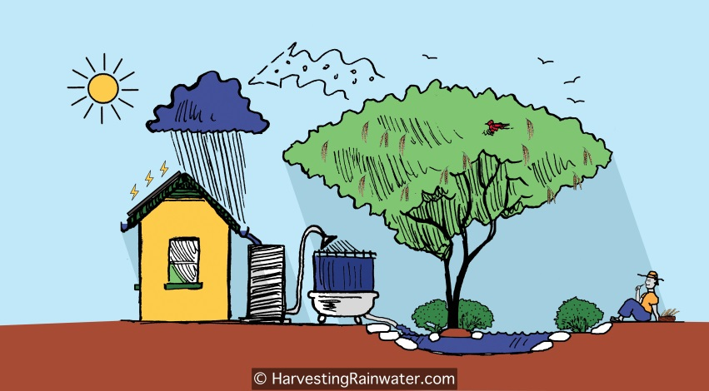
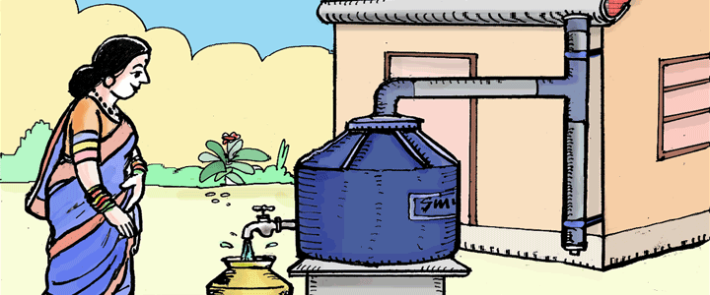
Water harvesting techniques are highly locale specific and
the benefits are also localized.
Giving people control over their local water resources ensures that mismanagement and over-exploitation of these resources is reduced/removed.

Slide 3
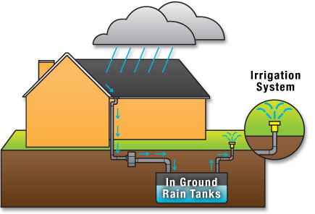
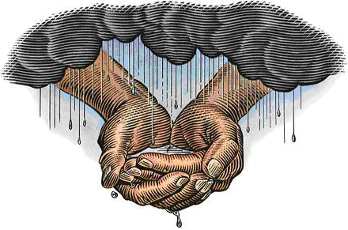
Water harvesting is an age-old concept in India.
Khadins, tanks and nadis in Rajasthan
Bandharas and tals in Maharashtra
Bundhis in Madhya Pradesh and Uttar Pradesh
Ahars and pynes in Bihar
Kulhs in Himachal Pradesh
Ponds in the Kandi belt of Jammu region
Eris (tanks) in Tamil Nadu
Surangams in Kerala
Kattas in Karnataka
are some of the ancient water harvesting, including water conveyance, structures still in use today.

Slide 4
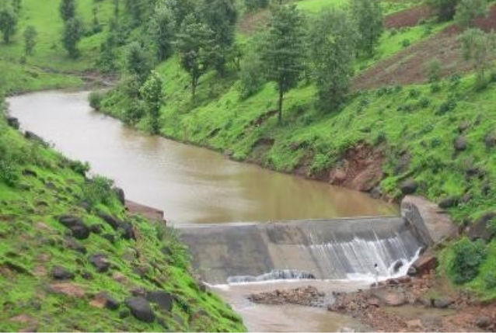
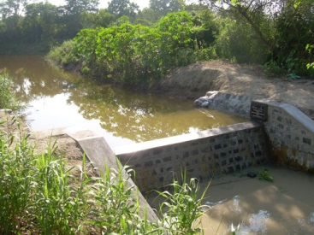
In largely level terrain, the water harvesting structures are
mainly crescent shaped earthen embankments or low, straight
concrete-andrubble “check dams” built across seasonally
flooded gullies.

Slide 5

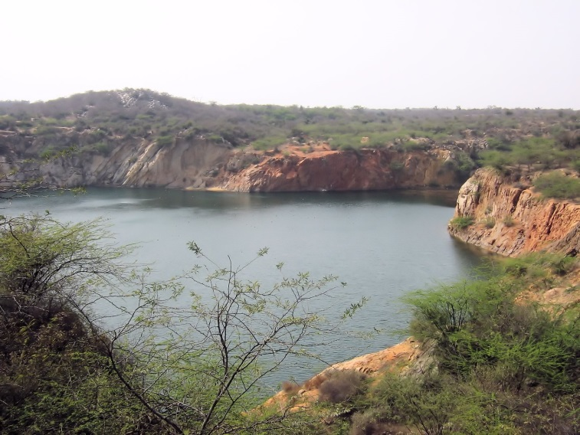
Monsoon rains fill ponds behind the structures.
Only the largest structures hold water year round; most dry up six months or less after the monsoons.
Their main purpose, however, is not to hold surface water but to recharge the ground water beneath.

Slide 6
The advantages of water stored in the ground are many.
It does not evaporate, but spreads out to recharge wells and provides moisture for vegetation over a wide area.
In addition, it does not provide breeding grounds for mosquitoes like stagnant water collected in ponds or artificial lakes.
The ground-water is also relatively protected from contamination by human and animal waste.

Slide 7
Thank You

